Slide 1
Final Project ESPM 174A:
El Niño Effects on Soil Moisture
Tyler Marino

Slide 2
How does the effect of snowpack on soil moisture content change as a results of high precipitation and snow runoff in years classified as El Niño?
::: Climate change’s relationship to weather patterns exhibited by El Niño events.
::: Soil moisture content affects likelihood of major natural disasters
::: Understanding the penetration of water in soil
Hypothesis:
An increased snowpack yields longer periods of melting, however higher temps and rain on snow events make through ice penetration difficult.

Slide 3
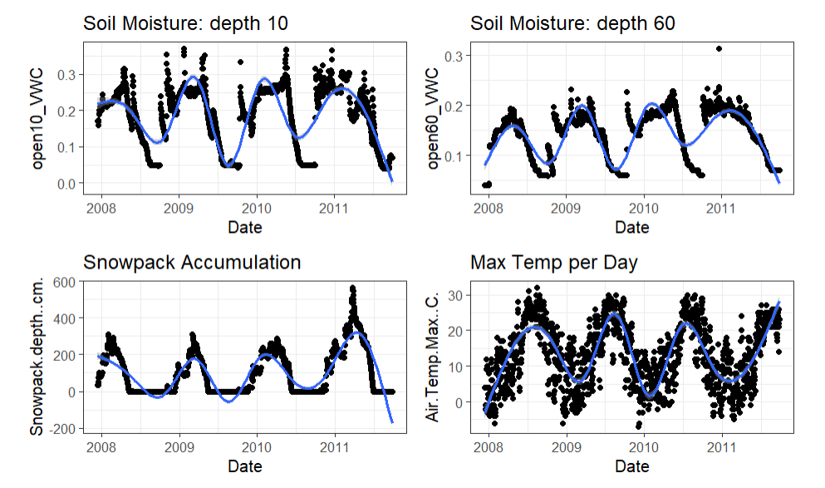
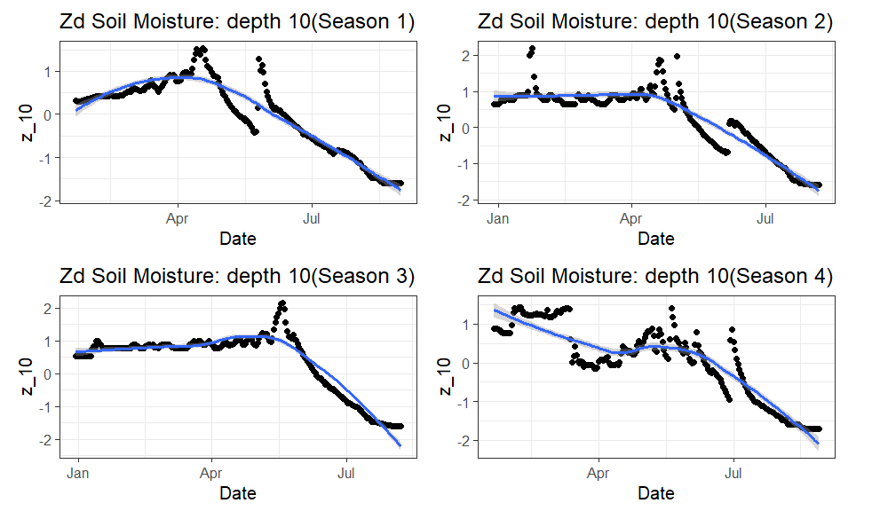
Data
Central Sierra Snow Laboratories
(UC Berkeley):
:::TimeFrame: 1971-2019.
:::Location: Donner Pass, Truckee CA.
:::Frequency: Daily.
:::Collecting: SnowPack depth, Maximum Airtemp.
:::Selected Time != TimeFrame.
Dr. Roger Bales SSCZO Soil Moisture
(UC Merced):
:::TimeFrame: 10/01/2008-10/01/2018.
:::Location: Providence.
:::Frequency: Hourly and Daily.
:::Collecting: Soil Moisture level at depths 10 and 60 cm.
:::Selected Time != TimeFrame.
d

Slide 4
MARSS>> Mar Model
Preparatory Work:
::: Airtemp and snowpack depth as covariates.
::: The 2 states are soil moisture at 10 and 60 cm depth.
::: Removal of the observational component.
::: Z transform all data.
Model:
Xₜ = Bxₜ₋₁ + U + Cc + Wₜ ~ {wᵢ = N(0, q)}
::: 4 model structures to fit over 4 seasons
::: Comparison of AICc
::: Interpretation of parameters

Slide 5
Season | Z Matrix | B Matrix (2x2) | Drift(U) | Q:Error Var | C Matrix | (R:Obs Var, A) | AICc
1 | Identity | Unconstrained | 0 | Diagonal/Unequal | Unconstrained | (0,0) | -1022.36
1 | Identity | Unconstrained | 0 | Diagonal/Equal | Unconstrained | (0,0) | -948.75
1 | Identity | Unconstrained | unequal | Diagonal/Equal | Unconstrained | (0,0) | -1029.59
1 | Identity | Unconstrained | 0 | Diagonal/Equal | Diagonal/Equal | (0,0) | -1029.55
2 | Identity | Unconstrained | 0 | Diagonal/Unequal | Unconstrained | (0,0) | -425.11
2 | Identity | Unconstrained | 0 | Diagonal/Equal | Unconstrained | (0,0) | -422.65
2 | Identity | Unconstrained | unequal | Diagonal/Equal | Unconstrained | (0,0) | -418.81
2 | Identity | Unconstrained | 0 | Diagonal/Equal | Diagonal/Equal | (0,0) | -427.85
4 | Identity | Unconstrained | 0 | Diagonal/Unequal | Unconstrained | (0,0) | -415.17
4 | Identity | Unconstrained | 0 | Diagonal/Equal | Unconstrained | (0,0) | -400.98
4 | Identity | Unconstrained | unequal | Diagonal/Equal | Unconstrained | (0,0) | -398.99
4 | Identity | Unconstrained | 0 | Diagonal/Equal | Diagonal/Unequal | (0,0) | -394.31

Slide 6
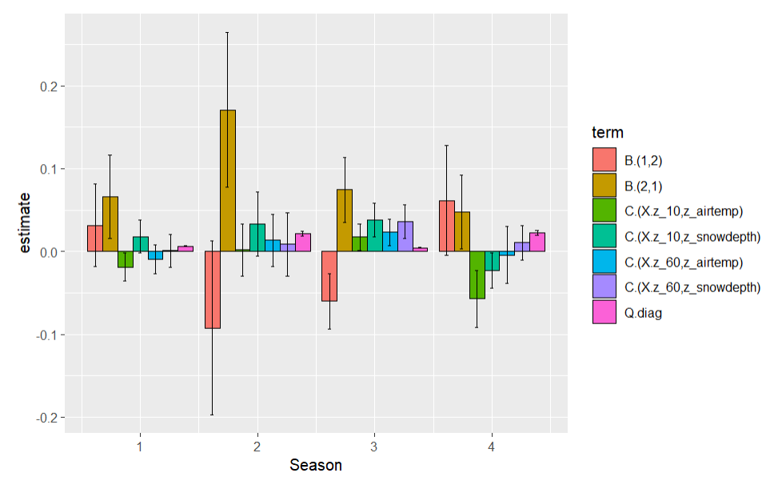
Findings
::: Near positive trend in interactions between soil moisture at both depths for 2011.
::: 2010 exhibits positive relationship between covariates and the data.
::: 2011 had negative trends for covariates with depth 10cm data.
::: Inconclusive how the increased snowpack affected depth 60cm soil moisture.

Slide 7
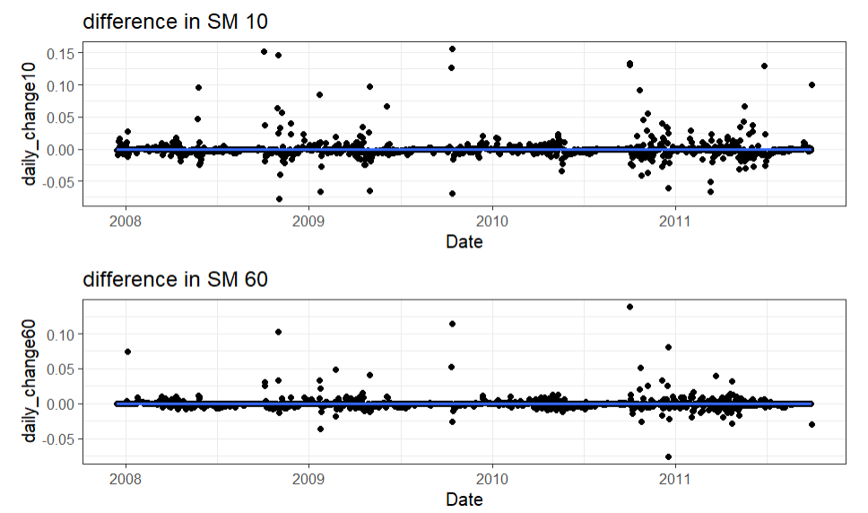
Advanced Research:
::: Effects of rain on snow events for water penetration.
::: Using differencing of state data.
::: Gathering a longer time series for analysis.
::: Fitting predictive modeling for soil moisture.

